Slide 1
SQL PROJECT
PROPERTY LISTING ANALYSIS FOR PROPERTY RENTAL COMPANY

Slide 2
Objective OF PROJECT
To analyse the working of Property Rental company.
To explore the trends for different property types listed on the rental company.
To study the trends of the different categories and provide insights on same.
To analyze if there is any correlation between property type and their availability across the months.
To explore the peak and off-peak time for the different categories of property type and their listings.

Slide 3
Categories on the basis of Acceptance Rate for all the property types
Worse = 0
Dull = 1 to 80
Average = 81 to 90
Good = 91 to 95
Excellent = 96 to 100

Slide 4
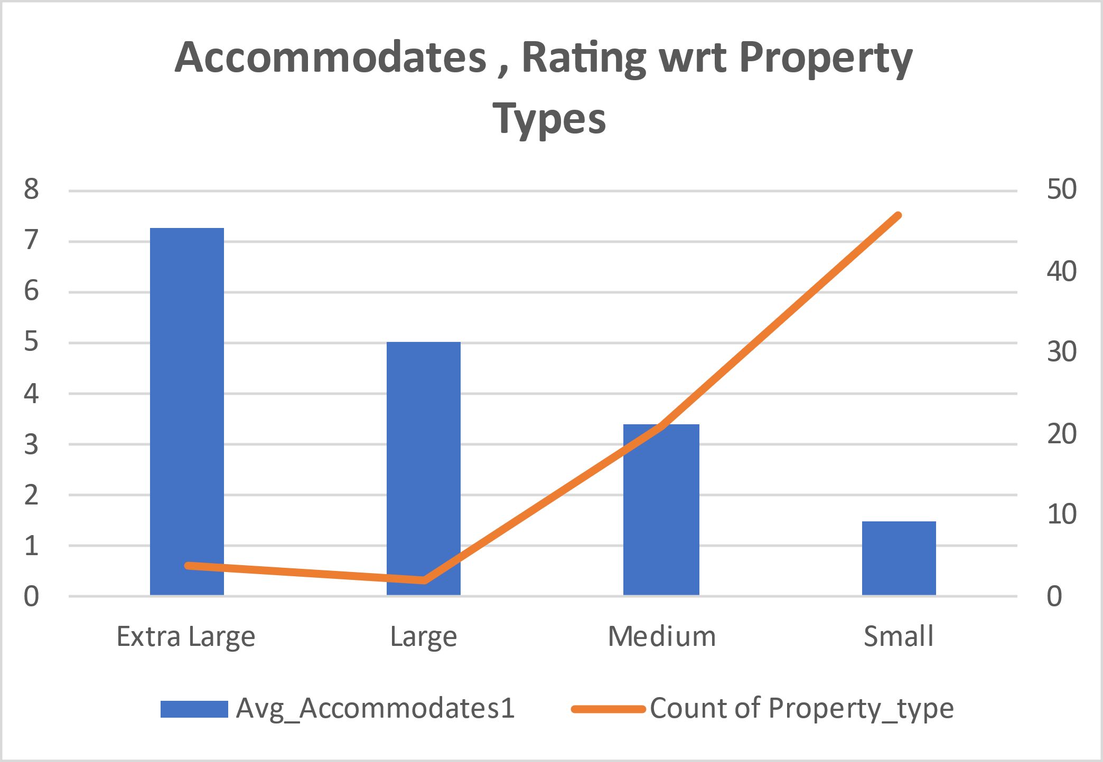
Categories on the basis of number of Accommodates for all the property types
Small = 1 to 2
Medium = 3 to 4
Large = 5
Extra Large = Greater Than 5

Slide 5
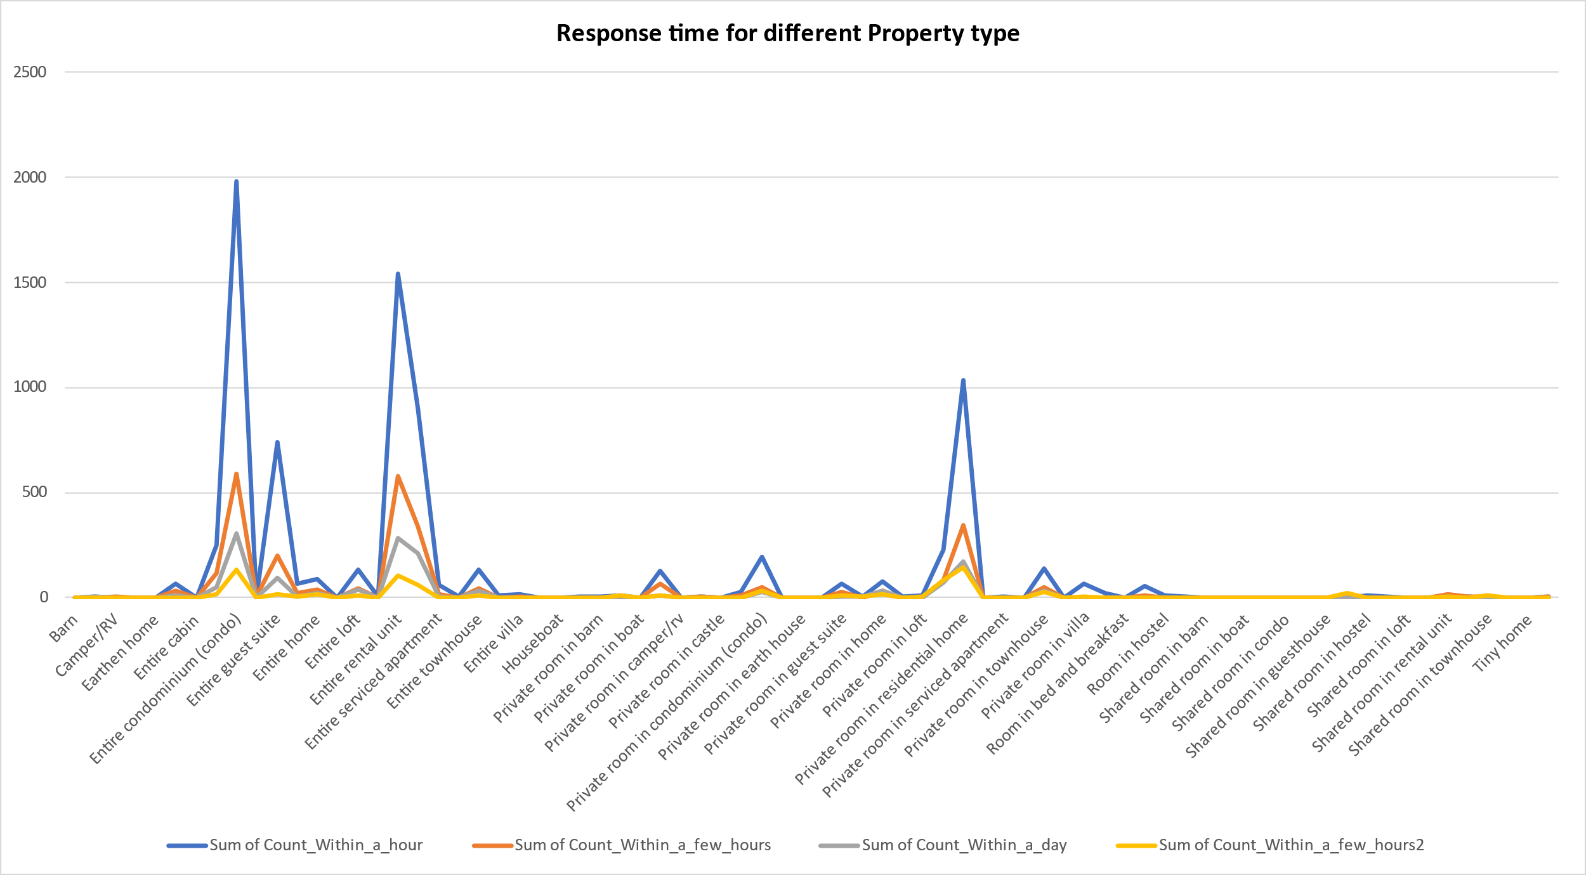
Response Time different property types

Slide 6
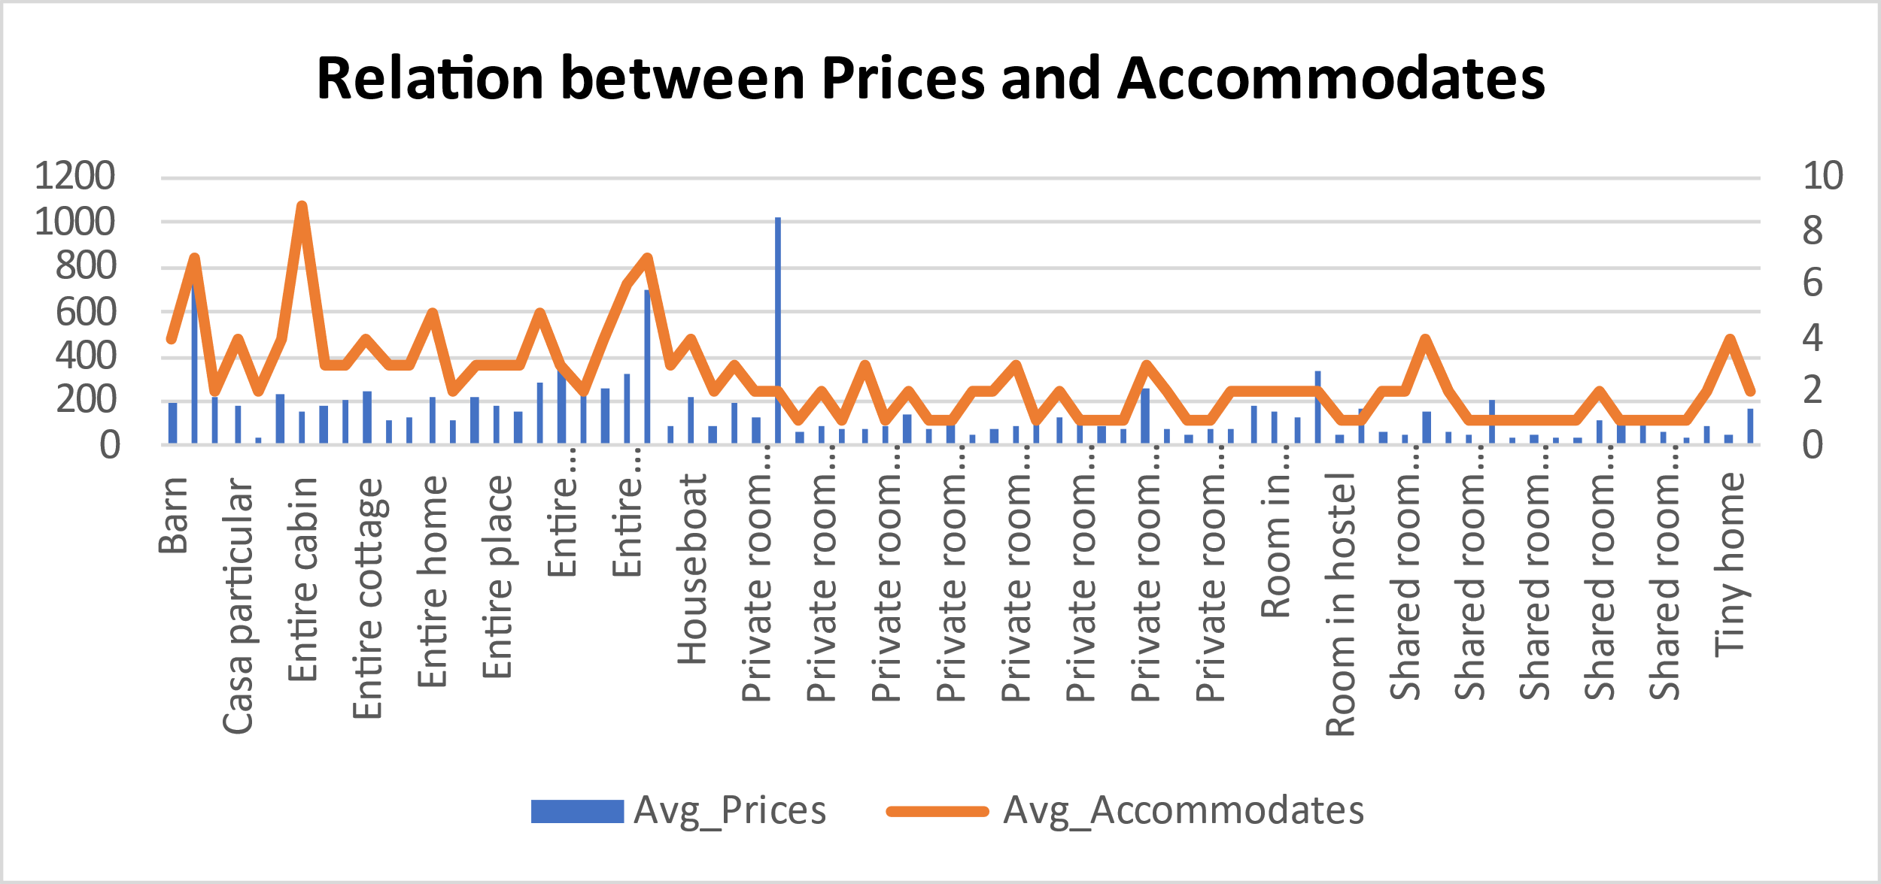
Relation Between prices and number of accommodates

Slide 7
Variation of comments for different property types

Slide 8
Monthwise Availability of listing

Slide 9
Price and Cleanliness Rating Comparison Between Toronto and Vancouver

Slide 10
Conclusions
Most of the reviews/ratings are positive
March – April and December month are Peak season while around June month is off peak season
Properties in Vancouver are way more costlier than properties in Toronto
Shared room has worst cleanliness rating and also priced low compared to other

